Slide 1
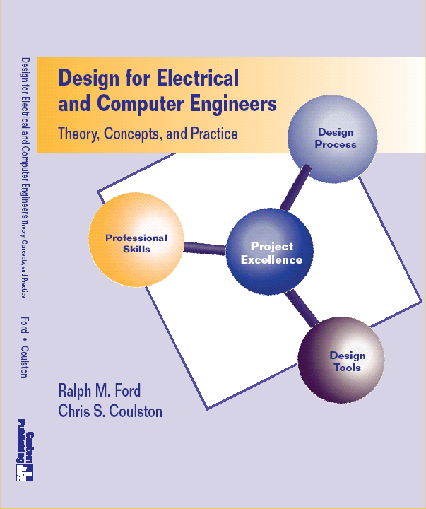
Chapter 3 – The Requirements Specification

Slide 2
Motivation – A Real Job Advertisement
Product Design Engineer (Electrical)
Duties and responsibilities of the position include: designing and developing new products and modifying/enhancing existing products to meet customer specification. This will be accomplished by communicating with internal and external customers to identify requirements; coordinating and implementing processes with manufacturing engineering based upon customer needs; and maintaining and/or creating supporting documentation

Slide 3
What came first?

Slide 4
Chapter 3 – Learning Objectives
By the end of this chapter, you should:
Understand the desired properties of an engineering requirement and know how to state them.
Have a familiarity with engineering requirements that are commonly specified in ECE systems.
Understand the desired properties of the complete Requirements Specification, as well as know how to develop and document it.
Be able to analyze the tradeoffs between requirements.
Be able to identify constraints and standards that apply to an engineering design problem.
Be able to develop a complete Requirements Specification document.

Slide 5
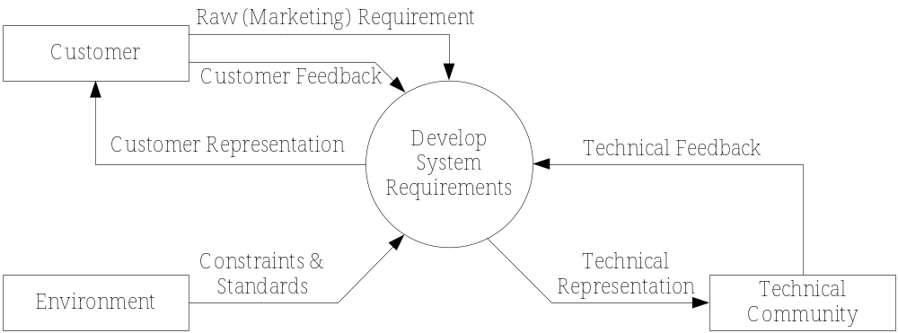
The Process

Slide 6
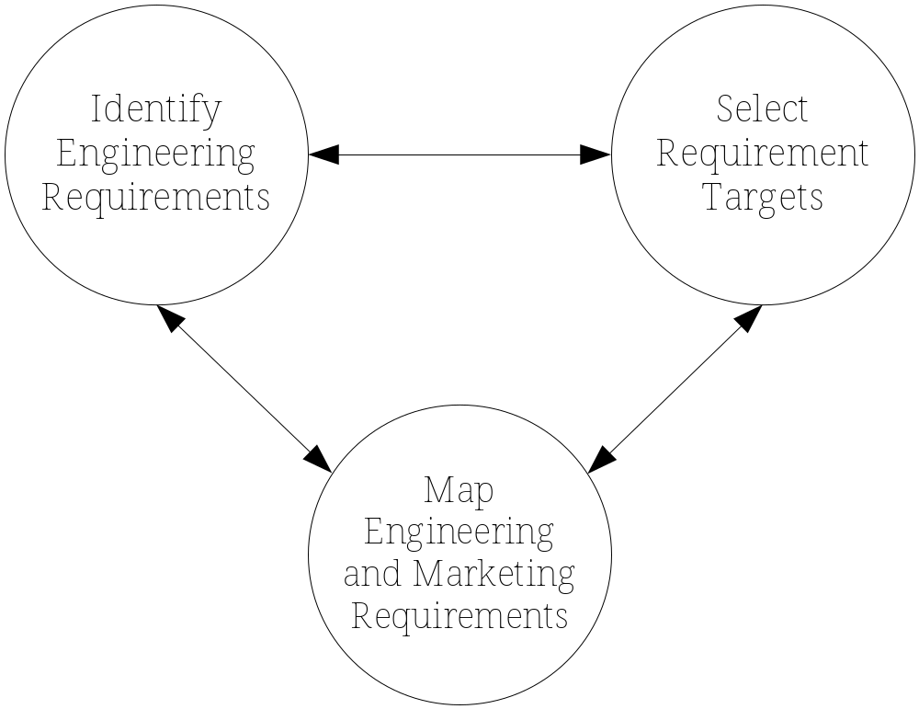
The Process, cont’d

Slide 7
Definitions
Marketing Requirement
Engineering Requirement
Requirements Specification

Slide 8
Definitions, cont’d
Functional Requirement
Technical Specification

Slide 9
Engineering Requirements

Slide 10
Engineering Requirement Properties
From IEEE Std 1233-1998.
Abstract
Unambiguous

Slide 11
Engineering Requirement Properties
Verifiable
Traceable

Slide 12
Example
Does the following requirement meet the four desirable properties? (abstract, unambiguous, verifiable, traceable)
“The robot must have an average forward speed of 0.5 feet/sec, a top speed of at least one foot/sec, and the ability to accelerate from standstill to the average speed in under one second.”

Slide 13
Example, cont’d

Slide 14
Example
Does the following requirement meet the four desirable properties? (abstract, unambiguous, verifiable, traceable)
“The robot must employ IR sensors to sense its external environment and navigate autonomously with a battery life of one hour.”

Slide 15
Example, cont’d

Slide 16
Example
Does the following requirement meet the four desirable properties? (abstract, unambiguous, verifiable, traceable)
“The audio amplifier will have a total harmonic distortion that is less than 2%.”

Slide 17
Example, cont’d

Slide 18
Example
Does the following requirement meet the four desirable properties? (abstract, unambiguous, verifiable, traceable)
“The system shall be easy to use by an intelligent 12 year old.”

Slide 19
Example, cont’d

Slide 20
Realistic Engineering Requirements
IMPORTANT – Your requirements for your project must also be REALISTIC.
=> You need to demonstrate that the target you have selected is technically feasible.
How are you going to do this?

Slide 21
Realistic Engineering Requirements, cont’d

Slide 22
Engineering Requirement Examples
Need to know what type of requirement to select for a given system.
These are but EXAMPLES – you must determine the correct ones for your system!
Hint: don’t just try to copy and paste them.

Slide 23
Engineering Requirement Examples
Performance & Functionality
The system should detect 90% of all human faces in an image.
The system should be able to measure part location to within ± 1mm.
The system should retrieve the user data within three seconds.
The system should be able to process video data at a rate of 30 frames per second.

Slide 24
Engineering Requirement Examples
Reliability & Availability
The system will have a reliability of 95% in five years.
The system will be operational from 4AM to 10PM, 365 days a year.
Energy
The system will operate for a minimum of three hours without needing to be recharged.

Slide 25
Engineering Requirement Examples
Environmental
The system should be able to operate in the temperature range of 0°C to 75°C.
The system must be waterproof and operate while submersed in water.
More in the book

Slide 26
The Requirements Specification

Slide 27
Requirements Specification
Definition

Slide 28
Importance

Slide 29
Properties of the Requirements Specification
From IEEE Std. 1233-1998.
Normalized/Orthogonal
Complete Set

Slide 30
Properties of the Requirements Specification
Consistent
Bounded

Slide 31
Properties of the Requirements Specification
Granular
Modifiable

Slide 32
Validation
Validation =

Slide 33
How do you VALIDATE requirements?
Ask the customer if the requirements meet their needs.
Usually done in teams.
For each engineering requirement
  Traceable?
  Verifiable?
  Realistic & technical feasible?
For the complete Requirements Specification
  Orthogonal?
  Complete?
  Consistent?

Slide 34
1-to-1 Mapping (Audio Amplifier)
Marketing Requirement
Should have excellent sound quality.
Engineering Requirement
Total harmonic distortion should be ≤ 1%.
Justification
Based upon competitive benchmarking and existing amplifier technology. Class A, B, and AB amplifiers are able to obtain this level of THD.

Slide 35
1-to-1 Mapping, cont’d
Marketing Requirement
Should have high output power.
Engineering Requirement
Should be able to sustain an output power that averages ≥ 35 watts with a peak value of ≥ 70 watts.
Justification
This power range provides more than adequate sound throughout the automobile compartment and is competitive in this price range.

Slide 36
1-to-1 Mapping, cont’d
Marketing Requirement
Should be easy to install.
Engineering Requirement
Average installation time for the power and audio connections should not exceed 5 minutes.
Justification
Past trials using standard audio and power jacks demonstrate that this is a reasonable installation time.

Slide 37
1-to-1 Mapping, cont’d
Marketing Requirement | Engineering Requirement | Justification
Should have excellent sound quality. | Total harmonic distortion (THD) should be ≤ 1%. | Based upon competitive benchmarking and existing amplifier technology. Class A, B, and AB amplifiers are able to obtain this level of THD.
Should have high output power. | Should be able to sustain an output power that averages ≥ 35 watts with a peak value of ≥ 70 watts. | This power range provides more than adequate sound throughout the automobile compartment and is competitive in this price range.

Slide 38
1-to-N Mapping (Experimental test)
Marketing Requirement | Engineering Requirement | Justification
The measurement of optical power should be accurate. | Must be able to measure the optical power output with an accuracy of ± 0.5dB. | This is based upon commercially available optical power measurement instruments.
Measure the effects of temperature variations on the optical power output. | Must be able to measure the optical power output from 10°C to 55°C. | This range simulates the operating environment, and 55°C is the maximum operating temperature of the card.
 | The system must maintain temperature accuracy to within ± 1°C during all tests. | Based upon accuracy of commercially available test chambers.

Slide 39
M-to-N Mapping (Audio Amplifier)
Marketing Requirements
The system should have excellent sound quality.
The system should have high output power.
The system should be easy to install.
The system should have low cost.

Slide 40
M-to-N Mapping, cont’d
Marketing Requirements | Engineering Requirements | Justification
1, 2, 4 | The total harmonic distortion should be <0.1%. | Based upon competitive benchmarking and existing amplifier technology. Class A, B, and AB amplifiers are able to obtain this level of level of THD.
1–4 | Should be able to sustain an output power that averages ≥ 35 watts with a peak value of ≥ 70 watts. | This power range provides more than adequate sound throughout the automobile compartment, and is competitive in this price range. It is a sustainable output power for projected amplifier complexity.
2, 4 | Should have an efficiency (η) >40 %. | Achievable with several different classes of power amplifiers.

Slide 41
Advanced Requirements Analysis

Slide 42
Why?
Understand tradeoffs.
Refine and improve the requirements.
Benchmark against other systems

Slide 43
Engineering-Marketing Matrix
 |  | THD | Output Power | η, Efficiency | Install Time | Dimensions | Cost
1) Sound Quality
2) High Power
3) Install Ease
4) Cost

Slide 44
Engineering-Marketing Matrix
Let’s take one of the entries and describe what it means.

Slide 45
Engineering Tradeoff Matrix
 |  | THD | Power | η, Efficiency | Install Time | Dimensions | Cost
 |  | - | + | + | - | - | -
THD | -
Output Power | +
η, Efficiency | +
Install Time | -
Dimensions | -
Cost | -

Slide 46
Competitive Benchmarks
 | Apex Audio | Monster Amps | Our Design
THD | 0.05% | 0.15% | 0.1%
Power | 30W | 50W | 35W
Efficiency | 70% | 30% | 40%
Cost | $250 | $120 | $100

Slide 47
The House of Quality
Another representation of
  Engineering-marketing tradeoff matrix
  Engineering tradeoff matrix
  Benchmarks
  Targets.
A QFD (Quality Functional Deployment) Six Sigma Tool.
See the book.
However, I prefer (over the house)
  X-to-Y Mapping + Eng-market matrix + eng tradeoff matrix + benchmarks

Slide 48
Let’s Review!
Engineering Requirement + properties
Mapping methods (1-to-1, 1-to-N, N-to-M)
Advanced Requirements Analysis
  Eng-Marketing tradeoffs
  Eng-Eng Tradeoffs
  Benchmarks

Slide 49
Non-Functional Requirements & Constraints

Slide 50
Functional, Non-Functional & Constraints
No completely agreed upon definition!
Functional Requirement
Non-Functional Requirement
Constraint
Notes:
Wikipedia
Functional requirement = something the system must do or a feature of the system
Sommerville says they are description of how system bhaves.
Non-functional requirement = property that system must have (availability, accessibility, etc.).
Sommerville – calls them constraints – ie. In conflict with Wikipedia.
Difficult to test => must test subjectively. Informally stated, hard to enforce. Usability, portability, robust, etc.
Constraint = Fixed limit on the the development. Must us certain O/S, programming language, or a standard.

Slide 51
Wikipedia quote. “Requirements are notoriously difficult to present at an ideal level.”
Ian Sommerville There are problems with natural language description of requirements. i.e. detremining functional vs. non-functional, making them precise, yet understandable.

Slide 52
Types of Constraints (Non-functional)
ABET Defines them as:
  Economic
  Environmental
  Ethical
  Health & Safety
  Manufacturability
  Political
  Social
  Sustainability

Slide 53
Constraint Examples
Legal Ethical
  The system will protect the user’s identity with 128-bit encryption.
  Only managers will be allowed access to personnel data.
Health & Safety
  The system will use only UL approved components.
  The final system will be tested at an independent laboratory for UL and CE approval.

Slide 54
Constraint Examples, cont’d
Manufacturability
  The system will be manufactured using three layer printed circuit board technology.
  The software will be distributed via the Internet.
  The product should be run on both Linux and Microsoft operating systems.
Social
  The product shall provide help menus to the user in either English or Spanish.
  The software will be designed to easily be used by operators on the manufacturing floor.

Slide 55
Standards
Why do we have standards?
Examples of standards
The use of a standard can be mandated as a non-functional requirement or constraint.
“The system will use 802.11b standard for data communication”

Slide 56
Project Application: The Requirements Specification
Needs, Objectives, and Background. See Chapter 2.
Functional Requirements.
  marketing requirements
  engineering requirements
  Advanced analysis
Non-functional requirements.
  Identify applicable constraints/non-functional requirements/standards – state them clearly in the language of requirements.

